Slide 1
Lecture 15
Scheduling III
National University of
Computer & Emerging Sciences

Slide 2
Schedulers
Short term Scheduler or CPU Scheduling
  Which program is to be run next
Long term Scheduler or Job Scheduler
  Which ready jobs should be brought to memory
  May need to invoke only when a process leaves the system
  Must make a careful selection

Slide 3
Non Preemptive / Preemptive Scheduling
Non Preemptive Scheduling
  Once the CPU has been allocated to a process, it keeps it until it Terminates or has to wait for:
    I/O
    Child process etc.
Preemptive Scheduling
  Possible to get the CPU back from a process, even if the process has not completed its execution.

Slide 4
Scheduling Algorithms
First come, First serve
Shortest Job First
Priority Scheduling
Round-Robin Scheduling
CFS
Multi-level Queue Scheduling
Multi-level Feed back queue Scheduling

Slide 5
An overview of CFS
The main idea behind the CFS is to maintain balance (fairness) in providing processor time to tasks.
To determine the balance, the CFS maintains the amount of time provided to a given task in what's called the virtual runtime.
  The smaller a task's virtual runtime the higher its need for the processor.

Slide 6
An overview of CFS
Rather than maintaining the tasks in a run queue, as has been done in prior Linux schedulers, the CFS maintains a time-ordered red-black tree.

Slide 7
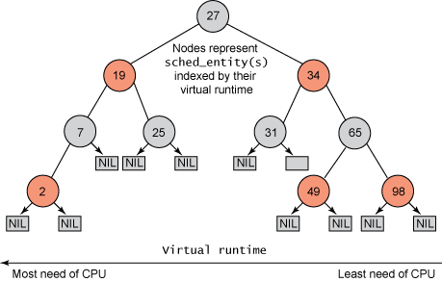

Slide 8
An overview of CFS
The scheduler then, to be fair, picks the left-most node of the red-black tree to schedule next to maintain fairness.
The task accounts for its time with the CPU by adding its execution time to the virtual runtime and is then inserted back into the tree if runnable.

Slide 9
An overview of CFS
In this way, tasks on the left side of the tree are given time to execute, and the contents of the tree migrate from the right to the left to maintain fairness.

Slide 10
Multilevel Queue Scheduling
Sometimes processes are classified into groups
One classification can be:
  Foreground (or Interactive) processes
  Background (or batch) processes
Different response time requirement
=> Different scheduling requirements
Foreground processes usually have higher priorities

Slide 11
Multilevel Queue Scheduling (MQS)
Partition the Ready queue into a number of queues
Processes are permanently assigned to one of the queues
Each queue may have its own scheduling algorithm
In addition, there must be scheduling between the queues

Slide 12
Multilevel Queue Scheduling
Example:
FCFS
Foreground Processes
Priority
Scheduling
RR
Background Processes

Slide 13
Multilevel Queue Scheduling
Example:
System Processes
Interactive Processes
Interactive editing Processes
Batch Processes
Student Processes

Slide 14
Multilevel Queue Scheduling
Each queue may have absolute priority over the other queue
Alternatively, Time slice between the queues
  Time slots can be equal
  Or
    80% time for Foreground processes
    20% time for Background processes
System Processes
Interactive Processes
Interactive editing Processes
Batch Processes
Student Processes

Slide 15
Multilevel Feedback Queue Scheduling
In Multilevel Queue a process is permanently assigned to a queue
The queue to which a process should belong is decided statically
Multilevel Feedback Queue Scheduling:
  A Process may move between the Queues
  Aging can be implemented this way.

Slide 16
Multilevel Feedback Queue Scheduling
Multilevel-feedback-queue scheduler defined by:
  Number of queues
  Scheduling algorithms for each queue
  Method used to select when upgrade process
  Method used to select when demote process
  Method used to determine which queue a process will enter when that process needs service

Slide 17
Multilevel Feedback Queue Scheduling
Example
  If a process used too much CPU time, then move it to a lower-priority queue
  If a process waits too long in a lower priority queue, then move it to a higher priority queue

Slide 18

Multilevel Feedback Queue Scheduling
Example: Three queues:
  Q₀ – RR time quantum 8 milliseconds
  Q₁ – RR time quantum 16 milliseconds
  Q₂ – FCFS
Scheduling
  A new job enters queue Q₀ served by RR.
  Then job receives 8 milliseconds.
  If not finished in 8 milliseconds, moved to Q₁.
  At Q₁ job served by RR.
  Then receives 16 milliseconds.
  If not complete, preempted and moved to Q₂.

Slide 19
Multilevel Feedback Queue Scheduling
Example (Explanation):
  The scheduler first executes processes in Q1, which is given a time quantum of 8 milli-seconds.
  If a process does not finish within this time, it is moved to the tail of the Q2.The scheduler executes processes in Q2 only when Q1 is empty.
  The process at the head of the Q2 is given a quantum of 16 milli-seconds. If it does not complete, it is preempted and is put into Q3.
  Processes in Q3 are run on an FCFS basis, only when Q1 and Q2 are empty.
  The scheduler executes processes in Q2 only when Q1 is empty.

Slide 20
Multilevel Feedback Queue Scheduling
Example (Explanation):
  A new job enters queue Q1 which is served RR.
  When it gains CPU, job receives 8 milliseconds.
  If it does not finish in 8 milliseconds, job is moved to queue Q2.
  At Q2 job is again served RR and receives 16 additional milliseconds
  If it still does not complete, it is preempted and moved to queue Q3.

Slide 21
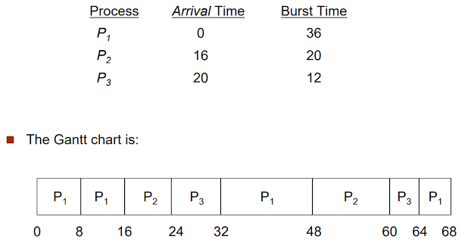
Multilevel Feedback Queue Scheduling
Example:

Slide 22
Multilevel Feedback Queue Scheduling
Example:

